Slide 1


Slide 2

Major Project-I (01CE0716)
Review 2
(23/08/2025)
TITLE: Advance digital forensic investigation tool for iot device
Team ID: 7CE_082
Team Member 1: JEET JOSHI (92310103088) (TC1)
Team Member 2: HITEKSHA THAKER (92310103102) (TC4)
Guided By
Internal Guide Name: HANSA VAGHELA
Department of Computer Engineering,
Faculty of Engineering & Technology

Slide 3
OUTLINE
Abstract
Introduction
Problem Statement
Technical Features And Elements
Working Of Forensic Tools
Applications Of the forensic tool
Advantages of the invention
Result
Flowchart of the investigations tool
Research Paper
Comparison
Reference
Conclusion

Slide 4
ABSTRACT

Slide 5
ABSTRACT
The sudden explosion of Internet of Things (IoT) devices particularly in today's homes has brought forth essential challenges around data security, digital privacy, and forensic traceability. Of all the devices, smart thermostats are particularly noted because they engage perpetually with user activity, environmental information, and remote access, which makes them vulnerable to cyberattacks and malicious access. This study introduces an Advanced Digital Forensic Investigation Tool for IoT Devices, with a special focus on smart thermostats, to tackle these new issues. The proposed tool is a modular, lightweight, and privacy-aware forensic framework for secure data acquisition, real-time monitoring, and intelligent evidence analysis. It combines the process of encrypted communication, anti-forensic resistance, and machine learning-based anomaly detection with captured data to ensure authenticity and integrity. The structuring of the tool is done to seamlessly operate within resource-constrained IoT settings and is cross-platform compatible for forensic investigators and security analysts. This paper presents a new solution that, in addition to enabling post-incident forensics, enables proactive forensic preparedness in IoT environments. The instrument enables legal admissibility of cyber evidence, meets privacy laws, and is easily extendible to many other IoT architectures beyond thermostats. Through the use of secure protocols, automated forensic capability, and modularity, this study fills the current gap between traditional forensics and the ongoing needs of intelligent environments.
Keywords: IoT forensics, smart thermostat, cybercrime investigation, forensic automation, digital evidence, anti-forensics, privacy-aware systems, real-time monitoring, forensic readiness

Slide 6
INTRODUCTION

Slide 7
INTRODUCTION
The widespread use of Internet of Things (IoT) devices, such as smart home products, wearables, and connected cars, has created major challenges for digital forensics.
These devices consistently generate, store, and send sensitive information.
This data is crucial evidence in cases of cybercrime, fraud, and data breaches.
The "Advanced Digital Forensic Investigation Tool for IoT Devices" project offers a specific forensic solution that can capture, analyze, and preserve digital evidence from various IoT environments.
It supports common communication protocols like HTTP, which allows it to collect network traffic, logs, device settings, and interaction histories.
By connecting traditional forensic methods with new IoT technologies, this system is a vital resource for modern forensic investigations.

Slide 8
PROBLEM
STATEMENT

Slide 9
PROBLEM STATEMENT
We are surrounded by devices that use the Internet of Things (IoT), a reality that has provided even more opportunities for cybercriminals to target us.
IoT devices have limited storage, limited processing, limited security features, and have been vulnerable to manipulation, remote access, and tampering.
A lot of digital forensic capabilities currently available to investigators (getting the evidence, storage and processing) cannot cope with the amount of devices in a decentralized, variable, and resource-poor IoT ecosystems.
The IoT environment has made it difficult for investigators to come up with legally acceptable and secure methods to recover and process digital evidence from the smart devices.

Slide 10
TECHNICAL FEATURES
AND ELEMENTS

Slide 11
TECHNICAL FEATURES AND ELEMENTS
Lightweight & Modular Form Factor:
Designed for low-resource IoT devices. Allows for flexible and plug-and-play modules.
Real-Time Data Collection:
Collects both volatile (RAM, processes in the process table), and non-volatile (logs, config, storage) data without impacting the operation of the device.
Chain of Custody:
Digital logs are maintained which are digitally signed with a timestamp to show every step of evidence handling to support and ensure its legal admissibility.
Anomaly Detection:
Incorporates Machine Learning modules built into the tool to identify suspicious, anomalous behavior in the IoT data.
Cross-Platform Compatibility:
Supports several IoT operating systems such as Linux-based IoT OS, Android Things.

Slide 12
WORKING OF
FORENSIC TOOLS

Slide 13
WORKING OF FORENSIC TOOLS
Initialization Phase
Acquisition Phase
Preservation Phase
Analysis Phase
Correlation Phase
Reporting Phase
Export Phase

Slide 14
APPLICATIONS
OF THE
FORENSIC
TOOL

Slide 15
APPLICATION OF FORENSIC TOOLS
Cybercrime Investigation
Smart Home & Industrial IoT Monitoring
Digital Evidence Collection
Automotive Forensics
Incident Response and Analysis
Compliance & Regulatory Audits
Fraud Detection
Academic and Research Use
Data Breach Forensics
Connected Healthcare Device Monitoring

Slide 16
ADVANTAGES OF
THE INVENTION

Slide 17
ADVANTAGES OF THE INVENTION
High precision in evidence collection for transient IoT environments.
Military encryptions strong enough to protect confidentiality, especially in dispute situations.
Platform-independent, ready for future IoT technologies.
Automates investigator workflows thanks to AI-based intelligence.
Provides solid forensic readiness rather than waiting for a breach to passively react.

Slide 18
RESULT

Slide 19
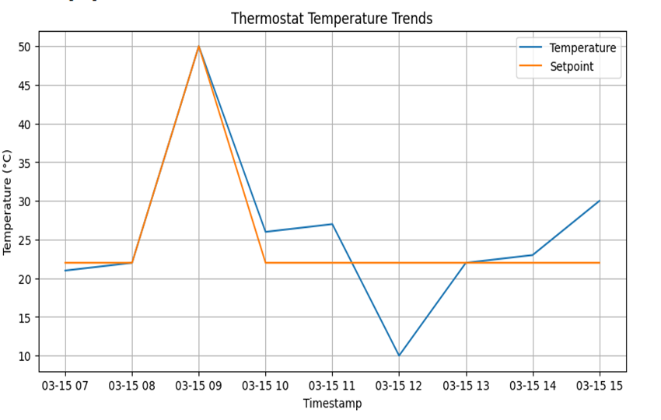
RESULT OF THERMOSTAT TEMPRATURE TRENDS

Slide 20
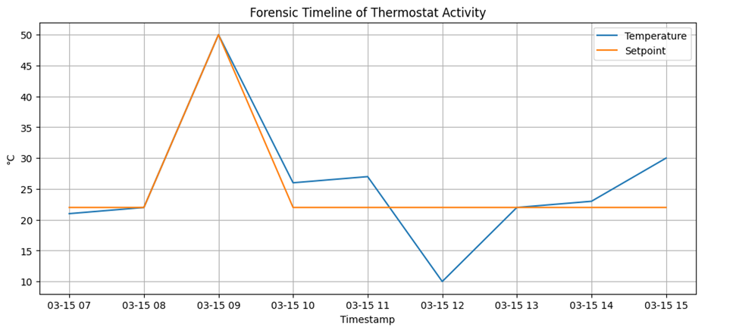
RESULT OF FORENSIC TIMELINE OF THERMOSTAT ACTIVITY

Slide 21
FLOWCHART

Slide 22
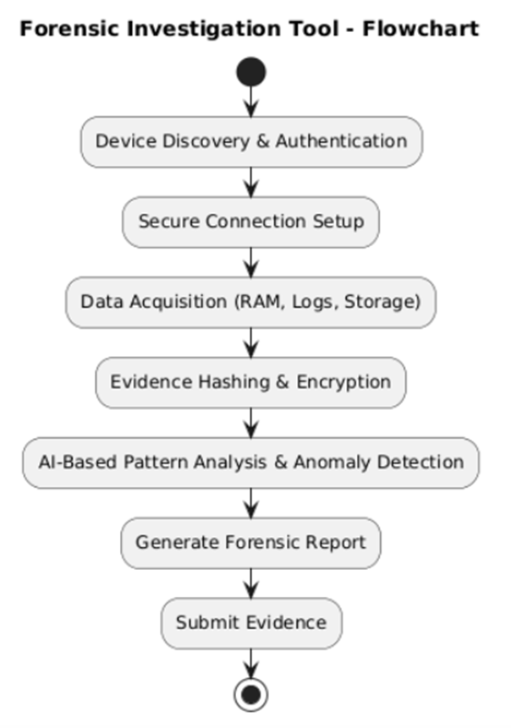
FLOWCHART OF THE INVESTIGATIONS TOOL

Slide 23
RESEARCH PAPER

Slide 24
REFERING RESEARCH PAPERS
Advanced digital forensics and anti-digital forensics for IoT systems: Techniques, limitations and recommendations

Slide 25
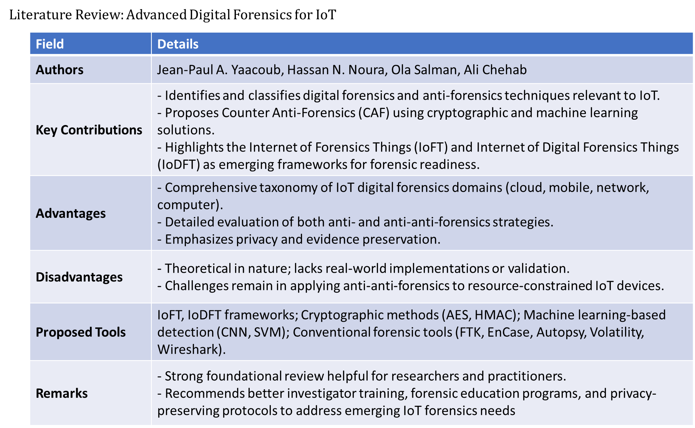
LITERATURE REVIEW
Advanced digital forensics and anti-digital forensics for IoT systems:
Techniques, limitations and recommendations

Slide 26
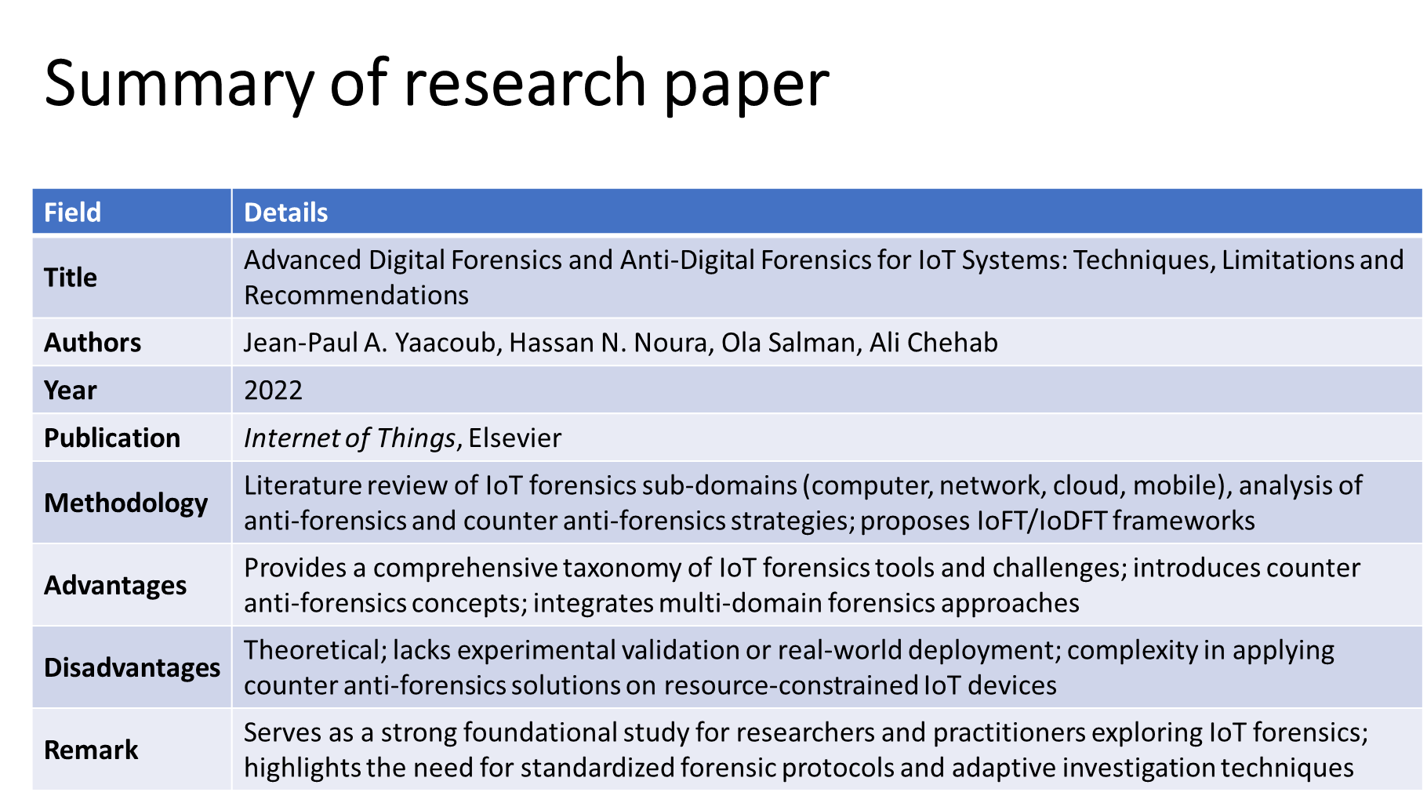
SUMMARY OF RESEARCH PAPER
Advanced digital forensics and anti-digital forensics for IoT systems:
Techniques, limitations and recommendations

Slide 27
REFERING RESEARCH PAPERS
Digital Forensics Analysis of IoT Nodes using Machine Learning
M Zeeshan Arshad1 , Hameedur Rahman2 , Junaid Tariq3 , Adnan Riaz4 , Azhar Imran4 , Amanullah Yasin4 and Imran Ihsan4

Slide 28
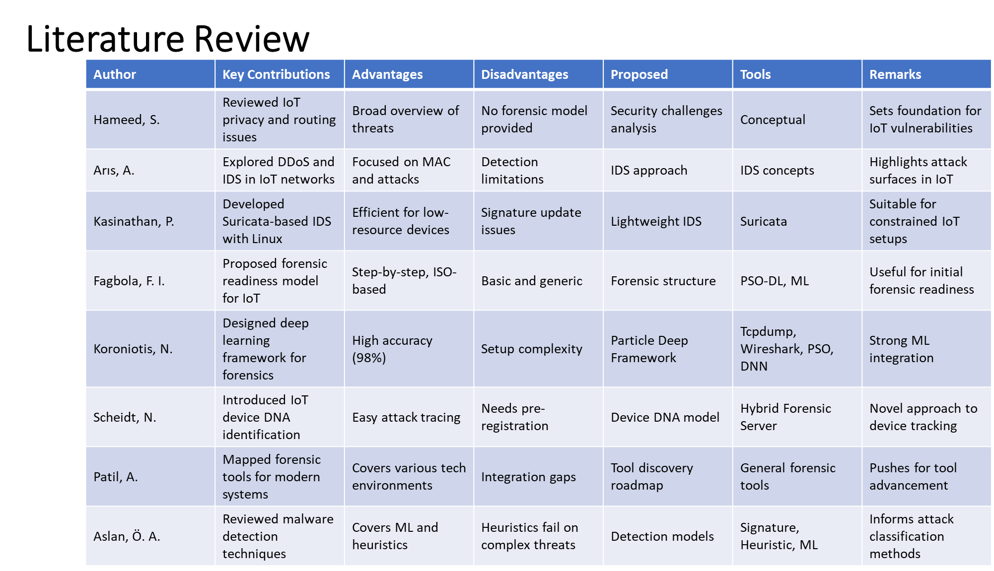
LITERATURE REVIEW
DIGITAL FORENSICS ANALYSIS OF IOT NODES USING MACHINE LEARNING
M ZEESHAN ARSHAD1 , HAMEEDUR RAHMAN2 , JUNAID TARIQ3 , ADNAN RIAZ4 , AZHAR IMRAN4 , AMANULLAH YASIN4 AND IMRAN IHSAN4

Slide 29
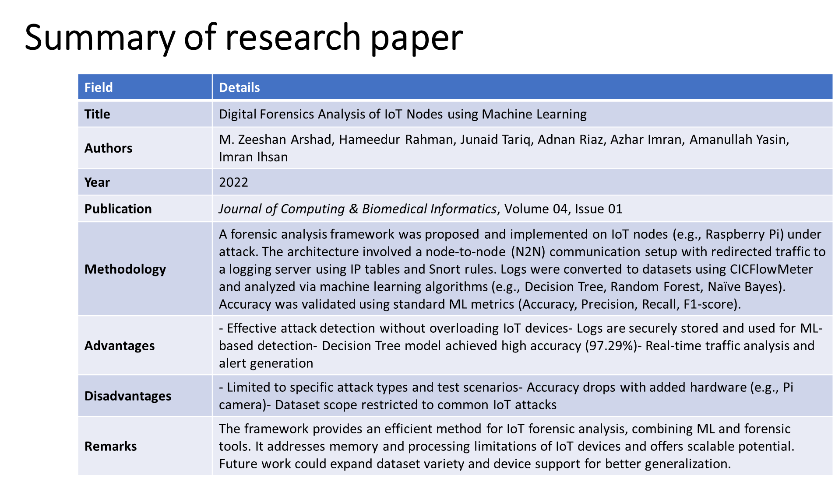
SUMMARY OF RESEARCH PAPER
DIGITAL FORENSICS ANALYSIS OF IOT NODES USING MACHINE LEARNING
M ZEESHAN ARSHAD1 , HAMEEDUR RAHMAN2 , JUNAID TARIQ3 , ADNAN RIAZ4 , AZHAR IMRAN4 , AMANULLAH YASIN4 AND IMRAN IHSAN4

Slide 30
COMPARISON

Slide 31
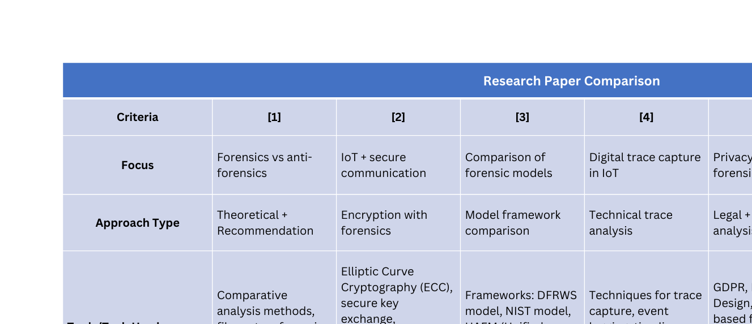
COMPARISON

Slide 32
REFERENCE

Slide 33
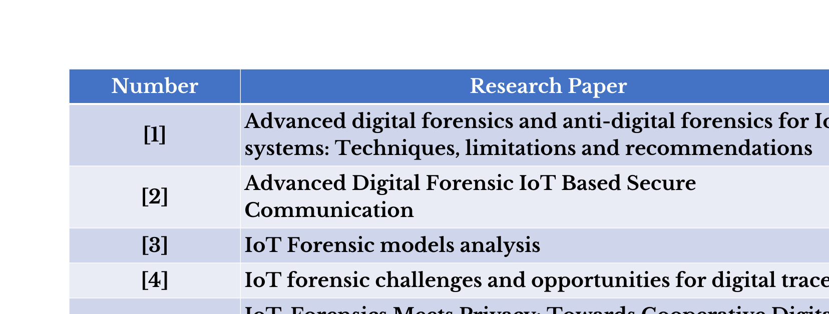
REFERENCE

Slide 34
CONCLUSION

Slide 35
CONCLUSION
The forensic tool being recommended can help significantly alleviate the shortfalls of traditional digital forensics in IoT situations. It provides safe, quick, low weighing evidence collection to enable data integrity and legal acceptability. This forensic tool is making use of encryptions, machine learning and malleable platforms to help provide higher accuracy and acceptability in investigations on smart devices for cyber crimes. This suggestion provides a framework for more scalable, smart and privacy-aware IoT forensics in today's digital world.

Slide 36


